Slide 1
Introduction to Computation
Fan Cheng Shanghai Jiao Tong University
http://www.cs.sjtu.edu.cn/~chengfan/
chengfan@sjtu.edu.cn
Autumn, 2022
Notes:
Numbers, floating numbers, string, mathematical expressions, print()

Slide 2
Outline
Basic data structure
Dict
String
Set

Slide 3
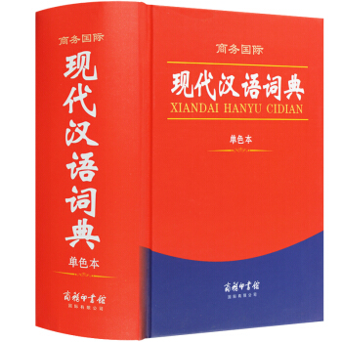
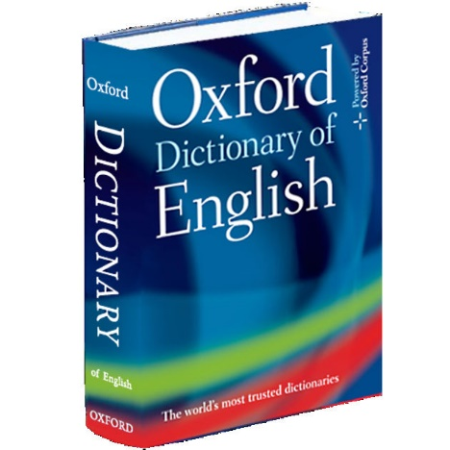
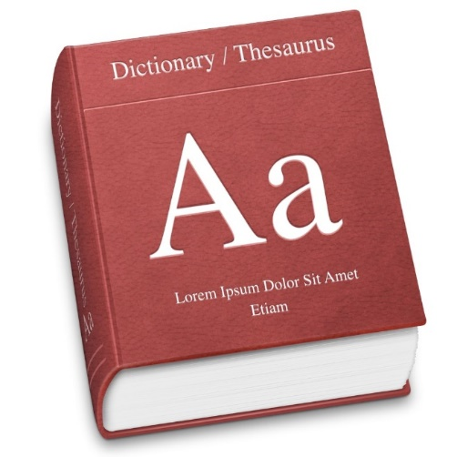
Dictionary
In Dict, we use keys to index values; it is unordered
Dict: Words and their interpretations
Word -- Key(关键字)
Interpretation – Value(值)
Dict is more efficient than list

Slide 4
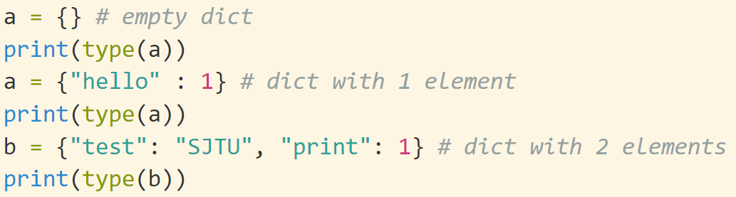


Dict: Creation
The elements of dict should be a pair like: key: value. “林则徐”: “民族英雄”
All the pairs are enclosed by {}
# Typo: a->b
The key can be any immutable type. 关键字是唯一的.
List type cannot be the key
List: []
Tuple: ()
Dict: {}
len(dict) returns the length of dict

Slide 5
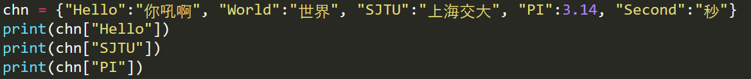


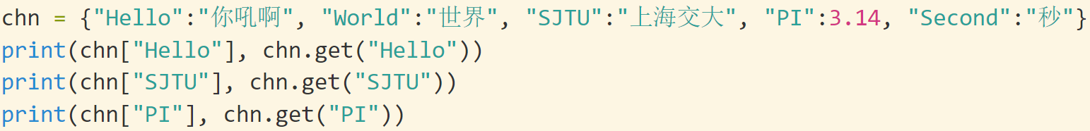
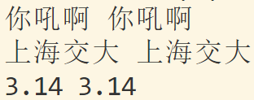
Dict: [], get()
Values of a dictionary can be accessed via dict[key]. If the key is not existed in the dict, an error will arise
Suppose we have a dict as follows:
chn = {"Hello":"你吼啊", "World":"世界", "SJTU":"上海交大", "PI":3.14,
"Second":"秒"}
All its keys are: “Hello”, “World”, “SJTU”, “PI”, “Second”
An error will arise if you use other values to access the chn
In principle, there is no order on the keys, unless you specify it. For example: a = {"test":1, 1.2:3, 3:"hello", 5:[1,2,3]}
get() that gives you the same result as [] does

Slide 6
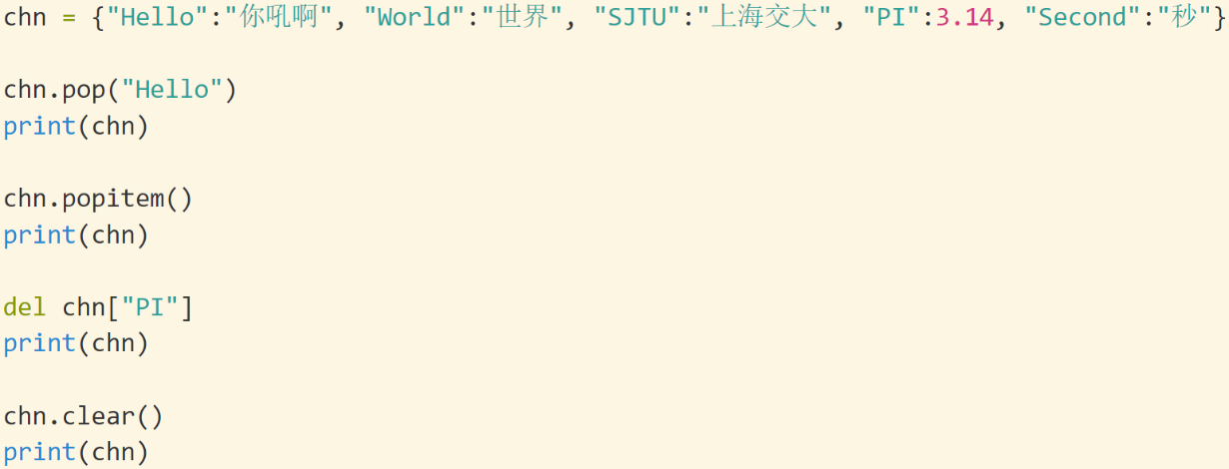
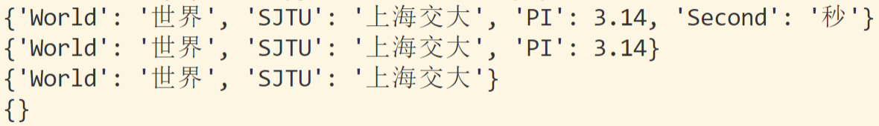
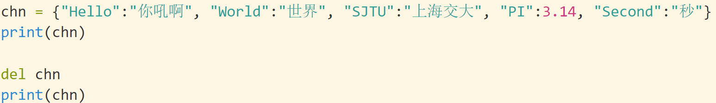
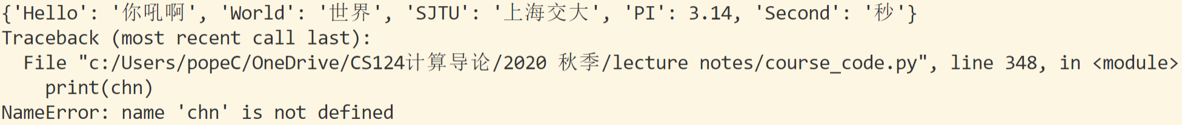
Dict: Removing Items
delete dict[key]: The del keyword removes the item with the specified key name
dict.pop(): The pop() method removes the item with the specified key name:
dict.popitem(): The popitem() method removes the last inserted item (in versions before 3.7, a random item is removed instead ☺
The del keyword can also delete the dictionary completely:

Slide 7
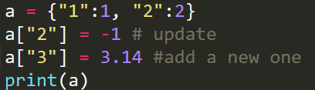


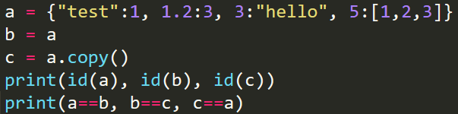

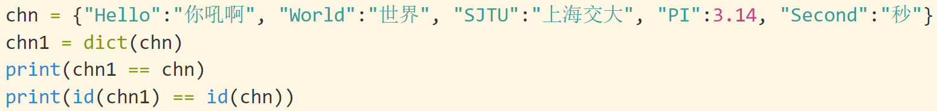

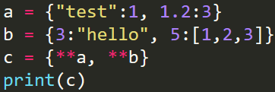
Dict: modification, copy and merge
The values can be reassigned/updated/added via its key
The dictionary in python is mutable. You need to make a copy in case of modification: dict.copy()
It is also possible to use the dict() constructor to make a new dictionary
b is the alias of a; c is a copy of a
When you need to merge two dictionaries x and y, z = {**x, **y}
How about a + b? a*3?

Slide 8
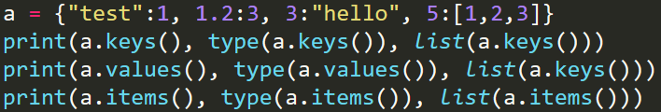
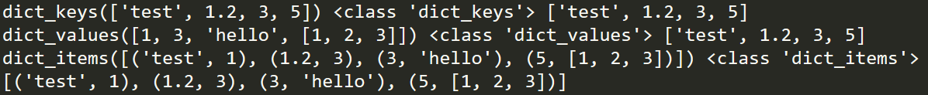


Dict: methods
For a dictionary dict, there are several methods to get its useful information:
dict.keys(), returns all its keys
dict.values(), returns all its values
dict.items(), returns all its items (key:value pairs)
dict.keys(), dict.values(), and dict.items() will not directly return a list. You should transform them yourself.
in and not in can be used to test the membership

Slide 9
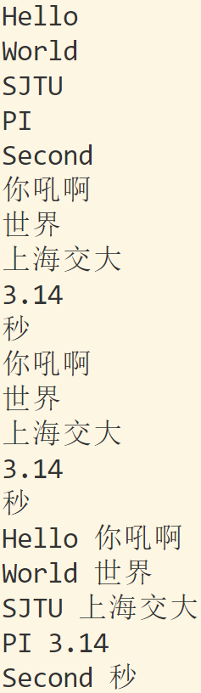
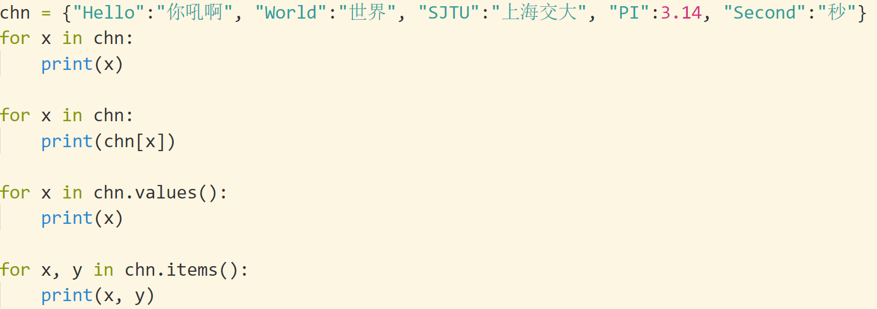
Loop Through a Dictionary
Print all key names in the dictionary, one by one:
For x in dict: print(x)
Print all values in the dictionary, one by one:
For x in dict: print(dict[x])
You can also use the values() method to return values of a dictionary:
for x in thisdict.values():
print(x)
Loop through both keys and values, by using the items() method:
for x, y in thisdict.items():
print(x, y)

Slide 10
Dictionary Methods
Python has a set of built-in methods that you can use on dictionaries.
Method | Description
clear() | Removes all the elements from the dictionary
copy() | Returns a copy of the dictionary
fromkeys() | Returns a dictionary with the specified keys and value
get() | Returns the value of the specified key
items() | Returns a list containing a tuple for each key value pair
keys() | Returns a list containing the dictionary's keys
pop() | Removes the element with the specified key
popitem() | Removes the last inserted key-value pair
setdefault() | Returns the value of the specified key. If the key does not exist: insert the key, with the specified value
update() | Updates the dictionary with the specified key-value pairs
values() | Returns a list of all the values in the dictionary

Slide 11
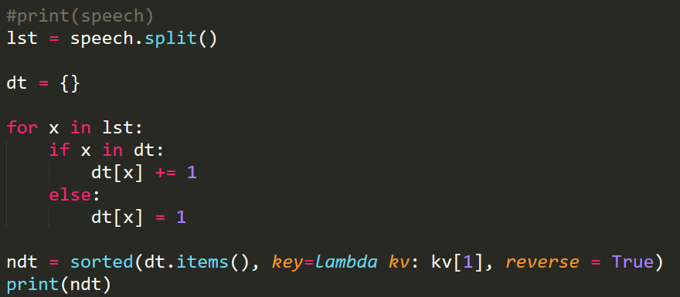
Dict应用：统计数量
Dict的结构中key:value, 其中value可用来保存有用的信息，譬如数量
给定一篇文章，统计每个单词出现的数量
http://en.sjtu.edu.cn/about-sjtu/presidents-welcome
speech = '''
Welcome to Shanghai Jiao Tong University!
Established in 1896 as Nan Yang College, Shanghai Jiao Tong University is one of the first
……
President of Shanghai Jiao Tong University
'''

Slide 12
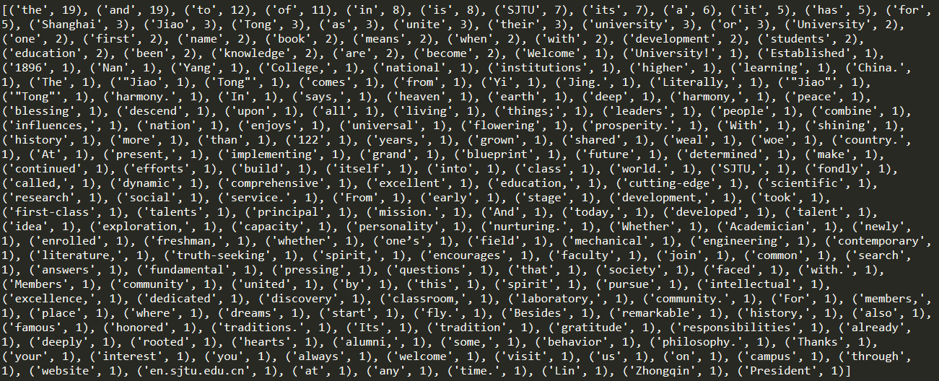
Dict is more efficient than list. When you need to store and search elements in a data strucute, Dict First

Slide 13

String
https://docs.python.org/3.8/library/string.html

Slide 14
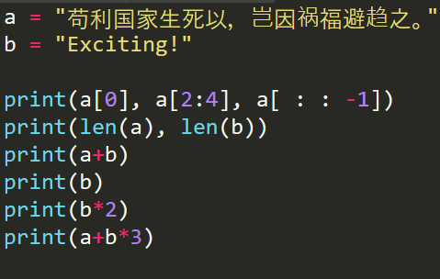
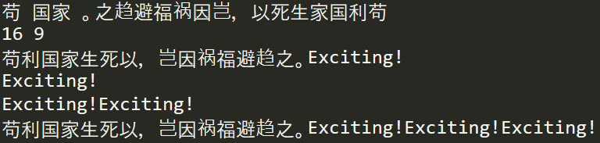



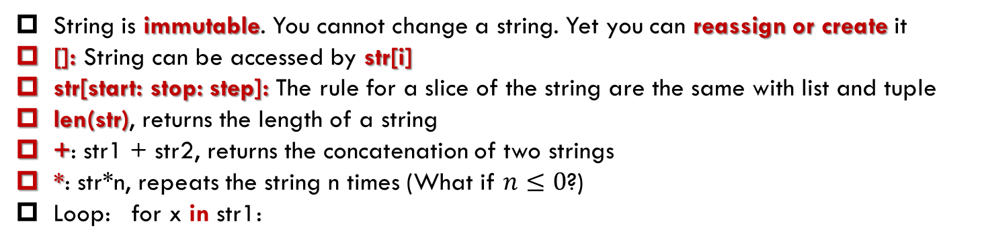
String: basics
String can be defined by “…”, ’…’, and “““…”””
Escape character: “\n”, “\t”
input(): always returns a string
String is immutable. You cannot change a string. Yet you can reassign or create it
[]: String can be accessed by str[i]
str[start: stop: step]: The rule for a slice of the string are the same with list and tuple
len(str), returns the length of a string
+: str1 + str2, returns the concatenation of two strings
*: str*n, repeats the string n times (What if $n≤0$?)
Loop: for x in str1:
string is an immutable list!
Modification? No! Reassignment? Yes!

Slide 15
String: >, =, <
Copy from Lect. 3
In practice, letters are ordered: ‘a’<‘b’<‘c’<…<‘z’
In ASCII, characters are ordered by their ASCII:
‘\n’<‘0’<‘9’<‘A’<‘Z’<‘a’<‘z’
In practice, letters are ordered: ‘a’<‘b’<‘c’<…<‘z’
Alphabetical order (https://en.wikipedia.org/wiki/Alphabetical_order) is a system whereby strings of characters are placed in order based on the position of the characters in the conventional ordering of an alphabet. For two strings,
Their first letters are compared. If they differ, then the string whose first letter comes earlier in the alphabet comes before the other string
If the first letters are the same, then the second letters are compared, and so on
If a position is reached where one string has no more letters to compare while the other does, then the first (shorter) string is deemed to come first in alphabetical order
In python, strings are compared by alphabetical order
>=, <=, ==, >, <, !=
How to get ASCII of ‘x’

Slide 16
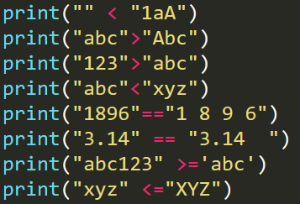

String: comparison
Copy from Lect. 3

Slide 17
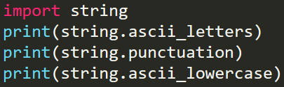

String module
Python provides string module, where many useful constants and methods are included
https://docs.python.org/3/library/string.html
To use this module, import string
import is a keyword, string is the name of module
string.ascii_letters
string.ascii_lowercase
string.ascii_uppercase
string.digits
string.hexdigits
string.octdigits
string.punctuation
string.printable
string.whitespace
string.asci_letters includes all the letters
string.punctuation includes all the punctuation
string.asci_lowercase includes all the lowercase letters

Slide 18
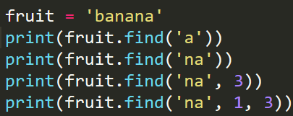


String: methods
Python string module provides several built-in functions to process strings
https://docs.python.org/3/library/stdtypes.html
str.find(sub, start, end): Return the lowest index in the string where substring sub is found within the slice s[start:end]. Optional arguments start and end are interpreted as in slice notation. Return -1 if sub is not found.
str.count(sub[, start[, end]]): Return the number of non-overlapping occurrences of substring sub in the range [start, end]. Optional arguments start and end are interpreted as in slice notation.

Slide 19
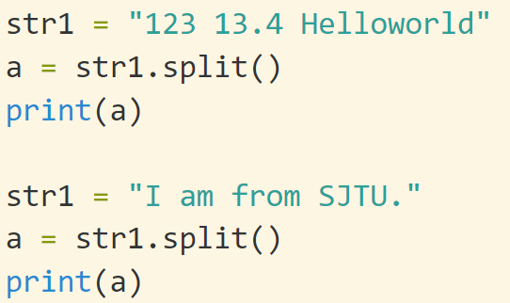
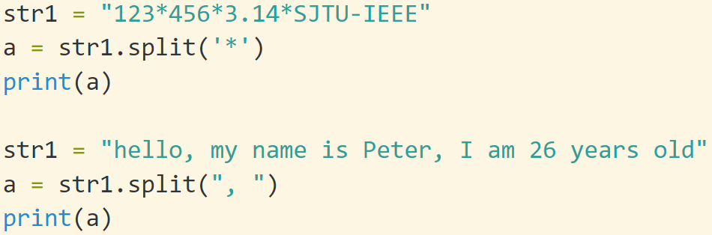

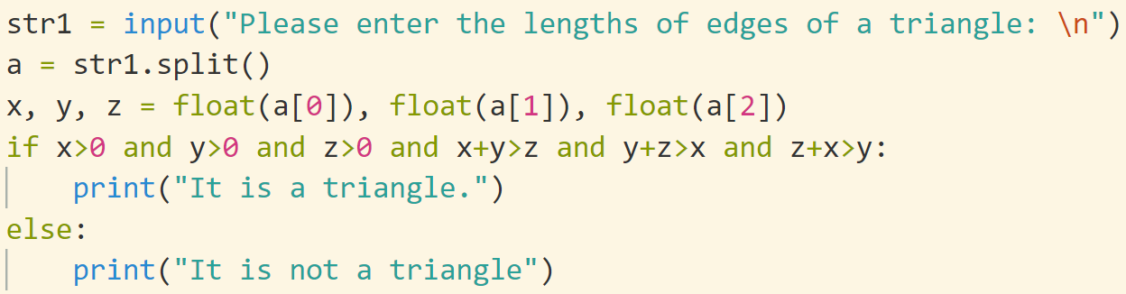
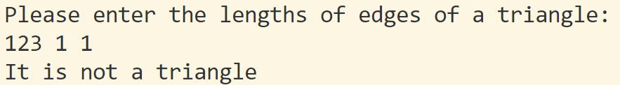
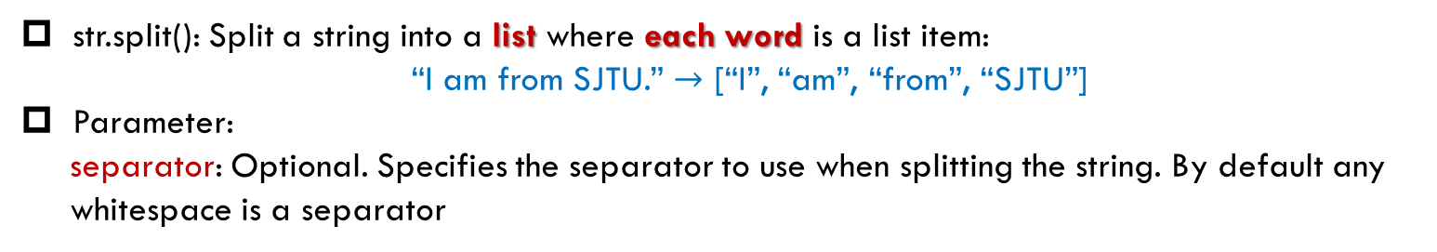
split(): split a string
str.split(): Split a string into a list where each word is a list item:
“I am from SJTU.” $→$ [“I”, “am”, “from”, “SJTU”]
Parameter:
separator: Optional. Specifies the separator to use when splitting the string. By default any
whitespace is a separator
默认分隔符：空格
自定义分隔符
实际应用

Slide 20
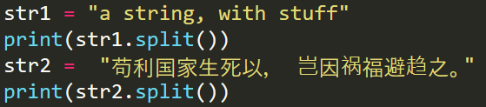

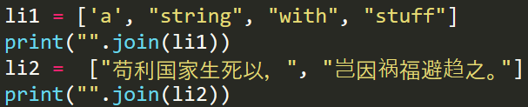

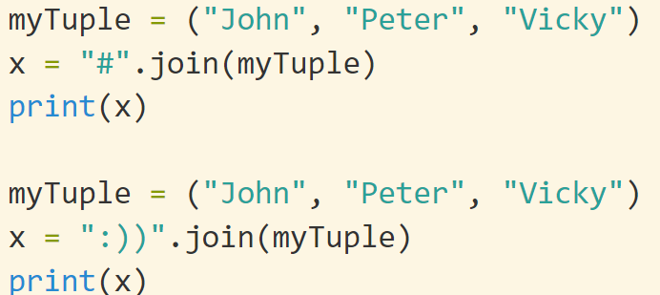
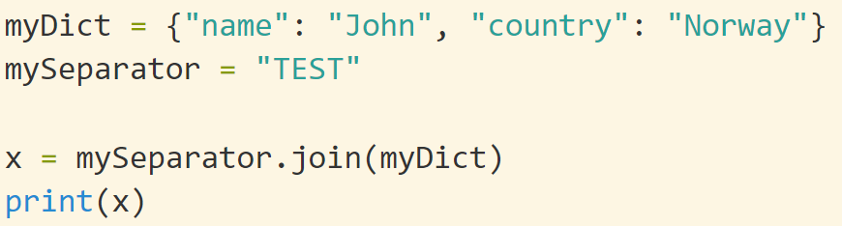


String: join()
str.join(): The join function is the inverse of split(). It takes a list of strings and concatenates the elements with a space between each pair
List!
str.join(): could also specify the separator letter
iterable

Slide 21
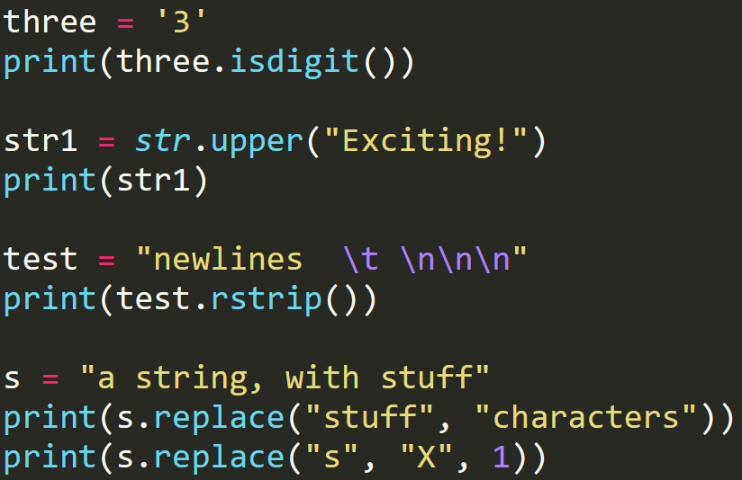
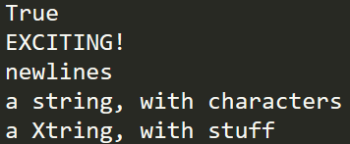


The strip() method removes any whitespace from the beginning or the end:
String: more
str.isdigit(): Return true if all characters in the string are digits and there is at least one character, false otherwise
str.upper(): Return a copy of the string with all the cased characters converted to uppercase
str.rstrip([chars]): Return a copy of the string with trailing characters removed
str.replace(old, new[, count]): Return a copy of the string with all occurrences of substring old replaced by new
Always check the string documents before implementing a function yourself
String can be processed directly on the content without defining a variable
https://www.w3schools.com/python/python_strings.asp

Slide 22
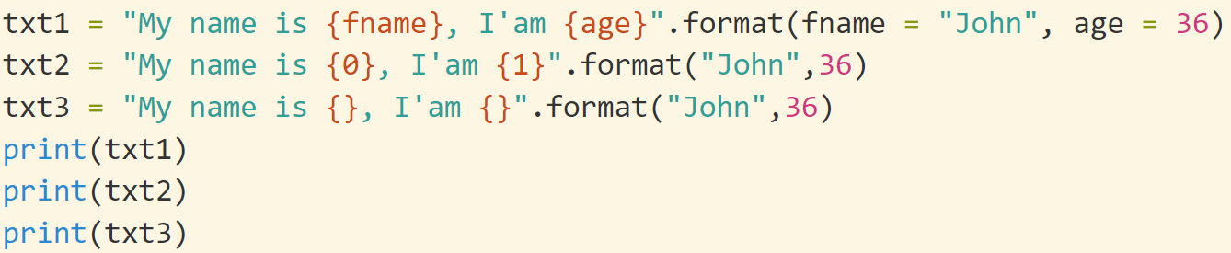
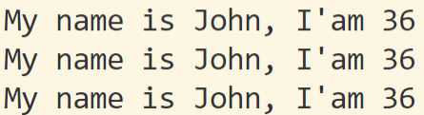
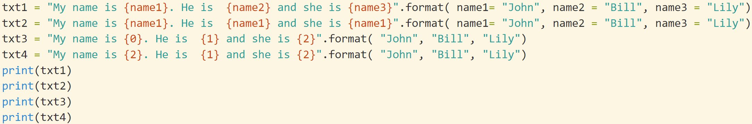
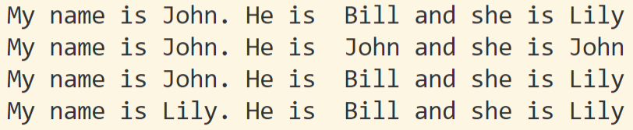
String.format()
“I am {} from {}”.format(name, city)
{}: placeholder 占位符
format(): formats the specified value(s) and insert them inside the string's placeholder. The format() method returns the formatted string.
You may use index or variable to denote the placeholders
#Accessing arguments by position or name

Slide 23
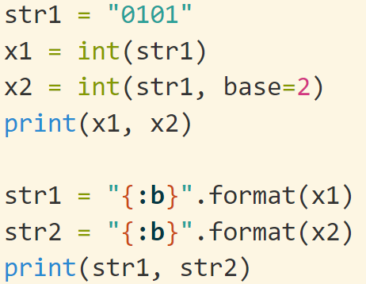
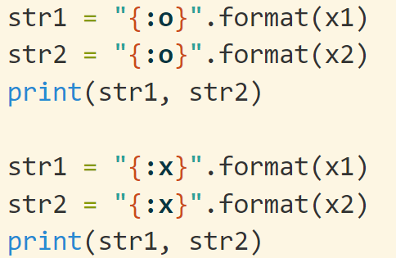


String.format(): b, o, x
d: 10进制(默认)
b, o, x: 二、八、十六进制
https://www.w3schools.com/python/ref_string_format.asp
https://docs.python.org/3.8/library/string.html

Slide 24
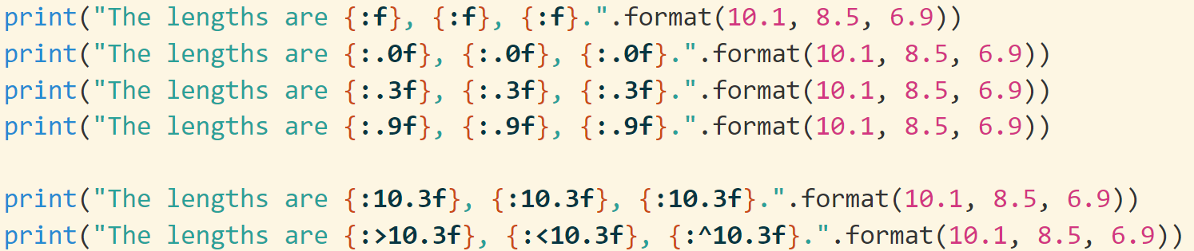
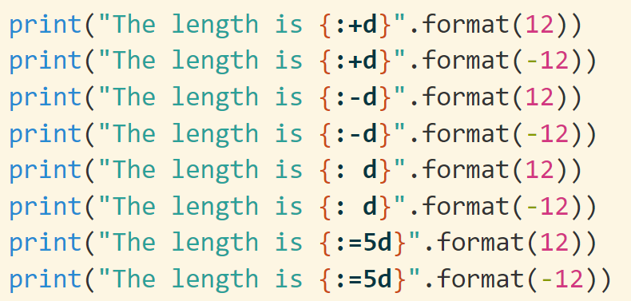
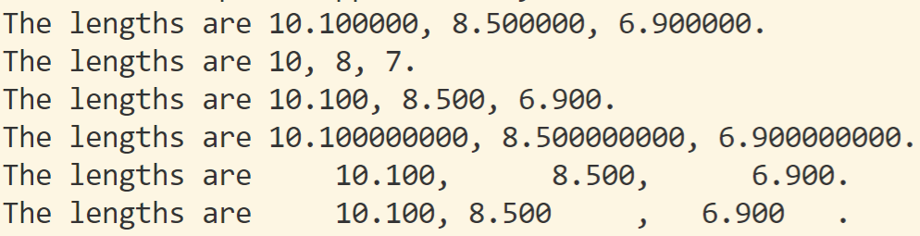
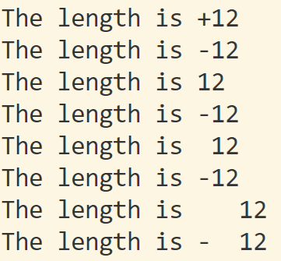

f: 浮点数 d: 10进制整数
c: 字符 s: 字符串
String.format(): f, d, c, s
默认6位小数
https://www.w3schools.com/python/ref_string_format.asp
https://docs.python.org/3.8/library/string.html

Slide 25
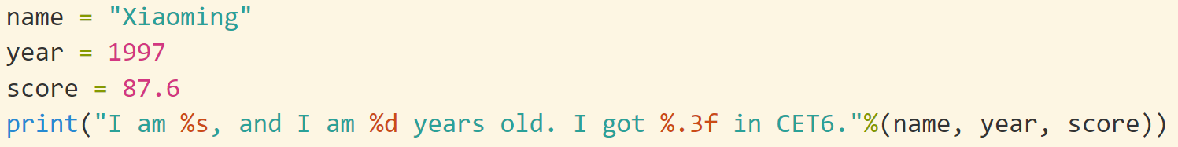
String: old style
“I am %s from %s”.%(name, city)
%: placeholder 占位符
f: 浮点数; d: 10进制整数; c: 字符; s: 字符串
手工一一对齐

Slide 26
String.format(): format types
:< Left aligns the result (within the available space)
:> Right aligns the result (within the available space)
:^ Center aligns the result (within the available space)
:= Places the sign to the left most position
:+ Use a plus sign to indicate if the result is positive or negative
:- Use a minus sign for negative values only
: Use a space to insert an extra space before positive numbers (and a
minus sign befor negative numbers)
:, Use a comma as a thousand separator
:_ Use a underscore as a thousand separator
:b Binary format
:c Converts the value into the corresponding unicode character
:d Decimal format
https://www.w3schools.com/python/ref_string_format.asp

Slide 27
String.format(): format types
:e Scientific format, with a lower case e
:E Scientific format, with an upper case E
:f Fix point number format
:F Fix point number format, in uppercase format (show inf and nan as INF
and NAN)
:g General format
:G General format (using a upper case E for scientific notations)
:o Octal format
:x Hex format, lower case
:X Hex format, upper case
:n Number format
:% Percentage format
https://www.w3schools.com/python/ref_string_format.asp

Slide 28
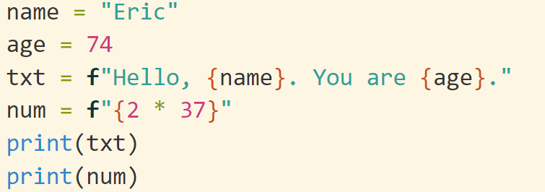




f-String: Formatted string literals
Repr,str
Python version $≥$ 3.6
Formatted string literals (also called f-strings for short) let you include the value of Python expressions inside a string by prefixing the string with f or F and writing expressions as {expression}.
https://docs.python.org/3/tutorial/inputoutput.html

Slide 29

Set

Slide 30


Set: create
A set is an unordered collection with no duplicate elements.
Basic uses include membership testing and eliminating duplicate entries (重复).
Set objects also support mathematical operations like
union, intersection, difference, and symmetric difference.
https://docs.python.org/3/tutorial/datastructures.html#sets
Curly braces or the set() function can be used to create sets.
Note: to create an empty set you have to use set(), not {}; the latter creates an
empty dictionary
fruit = {'apple', 'orange', 'pear', 'banana'}

Slide 31


Set: operations
A|B: Returns a set which is the union of sets A and B
A& B: Returns a set which is the intersection of sets A and B
A-B: Returns the set difference of A and B (the elements included in A, but not included in B)
A^B: Returns the symmetric difference of sets A and B (the elements belonging to either A or B, but not to both sets simultaneously)
A<=B: Returns true if A is a subset of B
A>=B: Returns true if B is a subset of A
Similar, A<B, A>B
A-B
A^B

Slide 32






set()
The parameter of set() can be type of string, list, dict
List, tuple: all the elements
Dict: all the keywords
String: all the characters
You cannot access items in a set by referring to an index, since sets are unordered the items has no index
To add one item to a set use the add() method
To add more than one item to a set use the update() method
To remove an item in a set, use the remove(), or the discard() method
The clear() method empties the set
All the above methods can be implemented by basic set operations
TypeError: unhashable type: 'list'

Slide 33




Code talks!

Slide 34

Built-in functions
The Python interpreter has a number of functions and types built into it that are always available. They are listed here in alphabetical order.
https://docs.python.org/3.8/library/functions.html
Tips: 当你需要实现一个基本的功能的时候，python可能已经帮你实现了

Slide 35
How to program
For most PLs like C++, Java, Python, etc..
Basic grammar structure (语句的意义 + 语句的语法)
Data types: inter, float, string
Expression: arithmetic, logic
Conditional expression
Loops
Advanced
Files
Class
Standard library
Complicated Hard
There are thousand methods to implement a feature
╳
Practice makes perfect

